Slide 1

Interview Preparation Application
Proposal and Feasibility Presentation Template
Group Members
Hozefa Hassan Rizvi (FA20-BSE-019)
Muhammad Hammad (FA20-BSE-031)
Ashar Ali(FA20-BSE-158)
Supervisor Name
Mam Sana Malik
Department of Computer Science
COMSATS University Islamabad, Abbottabad Campus

Slide 2
Agenda of the Presentation
Motivation
Brief Introduction
Scope
Functionalities
Proposed tool platform
Feasibility
Schedule
Task for 1st iteration (30%)
Conclusion

Slide 3
Motivation
Our motivation is to help graduates improve their chances of getting hired. The Interview Preparation Application is here to give candidates the skills they need to do well in interviews
As we know job interviews can be stressful, especially for recent graduates. We are offering a supportive environment where candidates can build their confidence, receive guidance, and engage with a community of like-minded individuals.

Slide 4
Brief Introduction
“Interview preparation application” is a platform tat provide an ease to candidates who want to prepare and boost up their confidence before appearing in an interview
This application is specifically for Software engineering graduates. We assume that they have enough knowledge of their field as we’re not providing textbooks content, we’re providing that data which help the candidate to successfully pass their interview

Slide 5
Brief Introduction
With a comprehensive approach, it offers more than just question-and-answer resources. It promotes a supportive community, connects candidates with industry experts and get tips from them and learn from their experience
Our app helps graduates transition from academic knowledge to practical skills essential for succeeding in real job interviews.

Slide 6
Scope
What to do:
Comprehensive Question Bank: We will develop an extensive database of interview questions and answers, covering various aspects of software engineering.
Expert Interaction: Users can connect with industry experts and successful candidates to seek guidance and advice.
Interview Performance Tracking: The app will allow users to track their interview preparation progress and identify areas for improvement.
User Contribution: We encourage active user participation, allowing them to contribute questions, answers, and insights to enrich the platform.

Slide 7
Scope
What not to do:
Textbook Content: Our focus is on interview-specific content. We won't provide textbook-style educational material unrelated to interview preparation.
Job Placement Services: While we aim to improve employability, we won't directly offer job placement or recruitment services within the app.
Certifications: Our application doesn't provide certification programs; it's purely for interview preparation and skill development.

Slide 8
Functionalities
User Authentication & Profile Setup: User can securely create account and setup profile
Question Bank: Access comprehensive database of relevant interview questions.
Community collaboration: Engage in discussions , share experiences , and provide feedback
Expert interaction: Seek advice from industry experts and successful candidates
User Contributions: Contribute questions , answers and insights
User Support: access a support system for assistance and feedback

Slide 9
Proposed Tools/Platform
Tools & Technology | Tools | Rationale
 | MS Word | Documentation
 | MS Excel | Data Organization
 | MS Power Point | Presentation
 | MS Project | Project Scheduling
 | MS Visual studio | IDE
 | Cloud Fire store | Database
 | Figma | Design/Prototypes
 | Technology | Rationale
 | Python | Backend language
 | JavaScript | Programming Language
 | React Native | App Development
 | OpenCV | Emotion Detection

Slide 10
Feasibility
Technical feasibility
Resources | Availability
Development Tool | Available
Programming Language | Available
Technologies | Available

Slide 11
Feasibility
Financial feasibility
Resource | Cost | Availability
Laptop | 50,000 Rs | Available
Android Phone | 30,000 Rs | Available
Firebase | Open Source (Free) | Available
OpenCV | Open Source (Free) | Available
React Native | Open Source (Free) | Available

Slide 12
Feasibility
Resource feasibility
    Working Laptop/PC are available for development
    All team members has required skills to develop the system.
    All requires tools and platform are available
    Internet connectivity is good
    The project is resource feasible

Slide 13
Feasibility
Operational feasibility
  The application aims to be user-friendly and accessible, ensuring that even users with basic technology skills can navigate and benefit from its features
  All the required resources are already available, and project is Operationally Feasible.

Slide 14
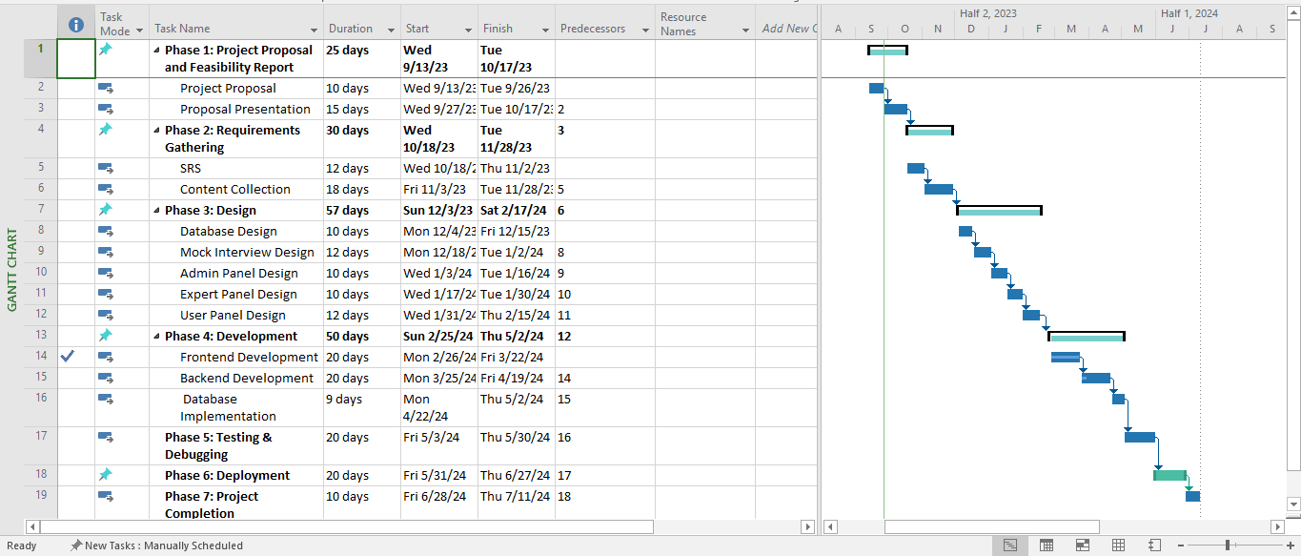
Schedule

Slide 15
Tasks for 1st Iteration (or 30%)
What will be completed as per Gantt Chart

Slide 16
Conclusion
To wrap it up, the "Interview Preparation Application" is a game-changer for software engineering graduates preparing for job interviews. It offers personalized learning, real-time expert help, and confidence-boosting tools. Our app creates a friendly community, provides lots of resources, and lets you see how you're doing step by step. This project's goal is to give graduates the skills they need to do great in software engineering interviews and kickstart their careers with confidence and ability.

